Slide 1
ThrYve Youth Justice Community Engagement Initiative
Vision: Empowered Youth Thriving in Safe & Prosperous Community
Center for Community Health and Development, Associate Director
Department of Applied Behavioral Science, Associate Professor
University of Kansas
Presentation to the KAG on February 27, 2018

Slide 2
WHO WE ARE
SOME PARTNERS
Wyandotte County Community Corrections
Notes:
1. Through multi-sectoral engagement, the SAB engages diverse representatives across sectors of the community are involved in guiding the effort.
2. Illustrative example of some of our nearly 50 partners include: the UG, KCKPD, local colleges,
3. In additional to Supt Lane, and DA Dupree, Judge York, Asst Cty Admin Gordon Criswell, DC Garner, NBC CDC, HNMA, and many more

Slide 3
KCK Collaborative Multisector Partnerships & Initiatives Related to Youth Justice
CHIP Violence Prevention Plan
HCW
Alive & Thrive
H.E.A.T. Youth Advisory Board
ThrYve
Youth Justice Community Engagement Initiative
Notes:
CHIP
Foster safer neighborhoods, free from violence.
Implement Crime Prevention Through Environmental Design (CPTED)
Add evidence-based violence prevention components (e.g. CPTED) to existing community programs (e.g. Safe Routes to School, Neighborhood Watch)
Concentrate all violence prevention strategies, including preventive community services that target risk factors (e.g. youth employment opportunities), in KCKPD districts with the highest rates of violent crime
Foster and promote community connectedness and resident supports.
Support creation of a Youth Community Advisory Board that focuses on promoting community development and reducing violence
Develop a Violence Prevention Community Health Worker program
Increase coordination among hospital-based violence intervention/survivor advocacy programs
Evaluate and improve communication and relations among residents and law enforcement agencies, other first responders, and the justice system.
Address cultural norms that tolerate or promote violence.
Develop and implement a violence prevention campaign among UG agencies for UG employees.
Convene a community-based committee to develop an effective cultural norms change campaign.
j

Slide 4
ThrYve Systems Advisory Board Structure
Executive Advisory Board
Systems Advisory Board
Youth Advisory Board
Youth Justice & Crime Prevention Action Team
Youth Opportunities Action Team
HEAT Youth CAB Participation (HEAT CAB)
Action Teams
NWMS ThrYve
Action Team
Sumner ThrYve
Action Team
WYHS ThrYve
Action Team
HPS ThrYve Action Team
After-School ThrYve Action Team
College, Education, & Career Team
OOS Time Programming Team
Parent, Family, & Community Engagement Action Team
Parent & Family Team
Community & Faith Team
Trauma, Social Service, & Support Action Team
JCAB
JIAC
YJCE Collaborative
YJCE Team
Crime Prevention Team
Notes:
Jomella
Developing change leve
The Systems Advisory Board organically produced 6 action teams, which are depicted in the figure on the These teams are the :
College, Technical, and Career Action Team
Crime Prevention, Justice, and Government Action Team
Education and Schools Action Team
Trauma, Social Service, and Support Action Team
Parent, Family, and Community Engagement Action Team AND THE
Youth Engagement and Enrichment Team
Supplemental:
SAB Sectors
Neighborhood/community based
Faith-based
Government
Health
Human/social services
Law enforcement
Courts/corrections
Media
Schools/educational institutions
Businesses
Community residents
Youth
Youth-serving organizations
rs

Slide 5
Youth Justice Community Engagement Initiative (YJCEI)
Initiative Overview

Slide 6
SPECIFIC KDOC COMMUNITY ENGAGEMENT GOALS
MAKE PROGRESS
GOAL 1
GOAL 2
GOAL 3
Increase community’s data analysis and interpretation capacity.
Complete a thorough data analysis of juvenile justice data from the past three years. Identify areas where outcomes for youth could be improved via justice system improvement or other system interventions
Increase community’s collaborative capacity. Assist to identify and approach other stakeholders that need to be brought in to address the identified system improvement needs
Increase community capacity to collect data from juvenile justice decision points.
Assist in collecting data for last three fiscal years
Notes:
1. Opportunity for year-round community program, including resource for summer program that we hope in partnership with schools
2. Awarded by HHS, OMH MYVPP2 Grant Program; FY17 Minority Youth Violence Prevention II (MYVP II): Integrating Social Determinants of Health and Community Policing Approaches
1 of 10 grantees (Loyola Univ-Chicago, Rutgers- NJ, Kentucky State Univ, ST Louis County Dept of PH,
3. 1 year grant of 4 year grant award-- Award amount is $425,000 (approximately $300,000 for Direct Costs for Project)
4. 3 Aims

Slide 7
KDOC COMMUNITY ENGAGEMENT INITIATIVE
DELIVERABLES
DELVIERABLE 1
DELIVERABLE 2
DELIVERABLE 3
Strategic plan, involving multi-sector stakeholders, and including strategies for best practices and methodologies related to: (a) sub-populations experiencing disparities (DMC; LGBTQI youth; undocumented youth/families), and, (b) effective approaches (Developmental Approach; Trauma Informed Care)
Toolkit with lessons learned to present to additional Kansas communities
JD #29 Juvenile Justice Needs & Resources Assessment to Improve Youth Outcomes
and Systems Enhancements
Notes:
1. Opportunity for year-round community program, including resource for summer program that we hope in partnership with schools
2. Awarded by HHS, OMH MYVPP2 Grant Program; FY17 Minority Youth Violence Prevention II (MYVP II): Integrating Social Determinants of Health and Community Policing Approaches
1 of 10 grantees (Loyola Univ-Chicago, Rutgers- NJ, Kentucky State Univ, ST Louis County Dept of PH,
3. 1 year grant of 4 year grant award-- Award amount is $425,000 (approximately $300,000 for Direct Costs for Project)
4. 3 Aims

Slide 8
KDOC – Services in Proposal & Adapted Timeline
Convene JJCE Action Team bimonthly (March ‘19)
Develop and document in CCB (March ’19 to Sept ’20)
Conduct community needs and resources assessment (Mar ‘19 to July ’19)
JJCE Action Team identifies sub-populations experiencing disparities and appropriate consultants and TA providers to enhance local understanding
Provide YJCEI Report (Sep ’19)
Develop and implement juvenile justice community engagement action plan (Sept ‘19 to Dec ‘19)
Develop and update online data portal with KBHID (July ‘19 to Sept 19)
Pilot tools, resources, guidance documents for toolkit (Aug ’19 to Aug ‘20)
Toolkit includes, minimally: assessment and strategic and action planning guide

Slide 9
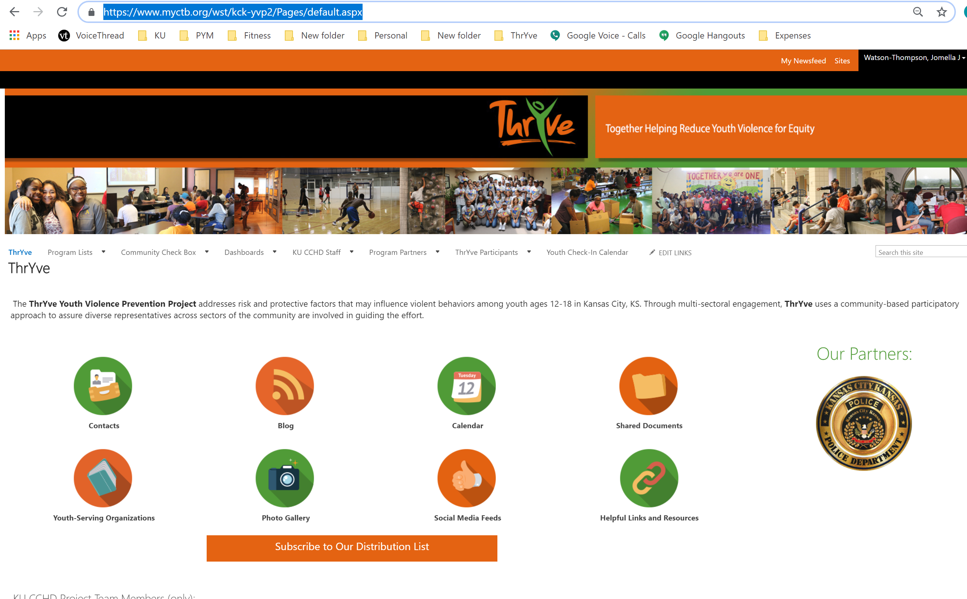

Slide 10
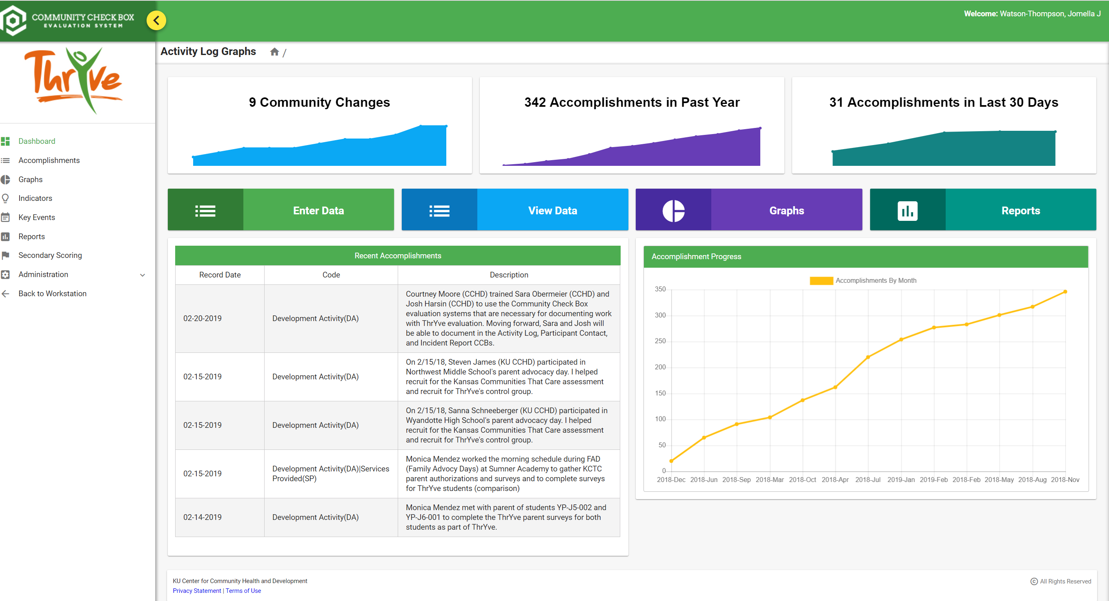

Slide 11
KDOC – Services in Proposal & Adapted Timeline
Convene JJCE Action Team bimonthly (March ‘19)
Develop and document in CCB (March ’19 to Sept ’20)
Conduct community needs and resources assessment (Mar ‘19 to July ’19)
JJCE Action Team identifies sub-populations experiencing disparities and appropriate consultants and TA providers to enhance local understanding
Provide YJCEI Report (Sep ’19)
Develop and implement juvenile justice community engagement action plan (Sept ‘19 to Dec ‘19)
Develop and update online data portal with KBHID (July ‘19 to Sept 19)
Pilot tools, resources, guidance documents for toolkit (Aug ’19 to Aug ‘20)
Toolkit includes, minimally: assessment and strategic and action planning guide

Slide 12
Short-term Objectives in Proposal
Goal 1: Increase community capacity to collect data from juvenile justice decision points, collect for last 3 fiscal years.
1.1: By March 2019 (Dec. 31, 2018), convene JJCE Action Team as sub-team of ThrYve SAB
1.1a:Engage additional stakeholders in JJCE Action Team
1.2: By April (Feb. 1), 2019, conduct stakeholder data mapping to identify data sources and methods for needs assessment and planning
1.2a: LTI and CCHD develop and administer community capacity assessment related to goals of DOC and JD
1.3: By May 1 (Mar. 1, 2019), develop assessment plan for community needs and resource assessment
1.3a: By April (Feb. 1), 2019, support stakeholder data mapping to begin to identify data sources, time periods, methods
1.3b: Engage 12 cross-sector partners in plan
1.3c: Conduct community assessment based on plan
Notes:
NATIONAL COUNCIL OF JUVENILE AND FAMILY COURT JUDGES | NATIONAL CENTER FOR JUVENILE JUSTICE;
Juvenile Justice Model Data Project 3D DATA CAPACITY ASSESSMENT

Slide 13
JJCE Initial Research Process
Identify Key Partners to Interview for WY juvenile justice system and youth-serving agencies
Data for last 3 years gathered for indicators, gaps identified
Data and qualitative responses shared with community (esp. youth and families affected) for feedback and development
Informational Interview & focus group participation requested
Surveys about outcomes/data capacity, gaps, and enhancement areas

Slide 14
KDOC – Services in Proposal & Adapted Timeline
Convene JJCE Action Team bimonthly (March ‘19)
Develop and document in CCB (March ’19 to Sept ’20)
Conduct community needs and resources assessment (Mar ‘19 to July ’19)
JJCE Action Team identifies sub-populations experiencing disparities and appropriate consultants and TA providers to enhance local understanding
Provide YJCEI Report (Sep ’19)
Develop and implement juvenile justice community engagement action plan (Sept ‘19 to Dec ‘19)
Develop and update online data portal with KBHID (July ‘19 to Sept 19)
Pilot tools, resources, guidance documents for toolkit (Aug ’19 to Aug ‘20)
Toolkit includes, minimally: assessment and strategic and action planning guide

Slide 15
Change Levers
Changing Consequences
Changing Policy & Systems
Program & Practices
Providing Information & Enhancing Skills
Policy & Systems
Enhancing Services & Supports
Modifying Access, Barriers, Opportunities
Notes:
A Lever- strong bar that is used to lift and move something heavy.
Based on principles of behavioral science
Focuses on antecedents (before behavior occurs; enables behavior) to support desired response
Providing information and enhancing skills
Providing Services and Supports
Modifying Access Barriers and Opportunities
Focuses on consequent conditions (after behavior/response occurs)
Change consequences (e.g., Cease Fire)
Change policies & broader systems (e.g.,

Slide 16
KDOC – Services in Proposal & Adapted Timeline
Convene JJCE Action Team bimonthly (March ‘19)
Develop and document in CCB (March ’19 to Sept ’20)
Conduct community needs and resources assessment (Mar ‘19 to July ’19)
JJCE Action Team identifies sub-populations experiencing disparities and appropriate consultants and TA providers to enhance local understanding
Provide YJCEI Report (Sep ’19)
Develop and implement juvenile justice community engagement action plan (Sept ‘19 to Dec ‘19)
Develop and update online data portal with KBHID (July ‘19 to Sept 19)
Pilot tools, resources, guidance documents for toolkit (Aug ’19 to Aug ‘20)
Toolkit includes, minimally: assessment and strategic and action planning guide

Slide 17
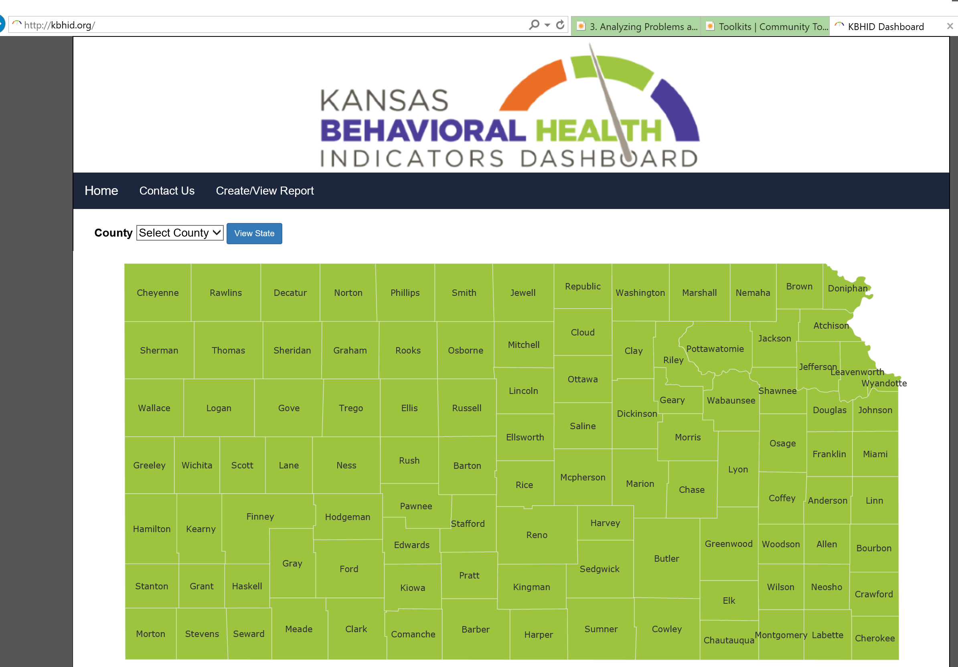

Slide 18
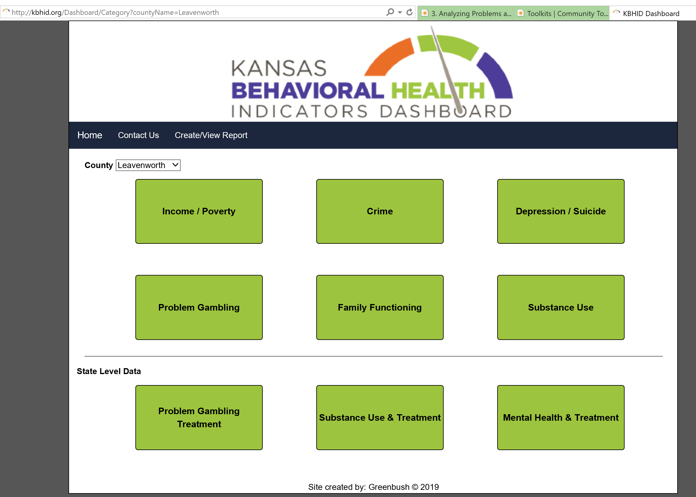

Slide 19
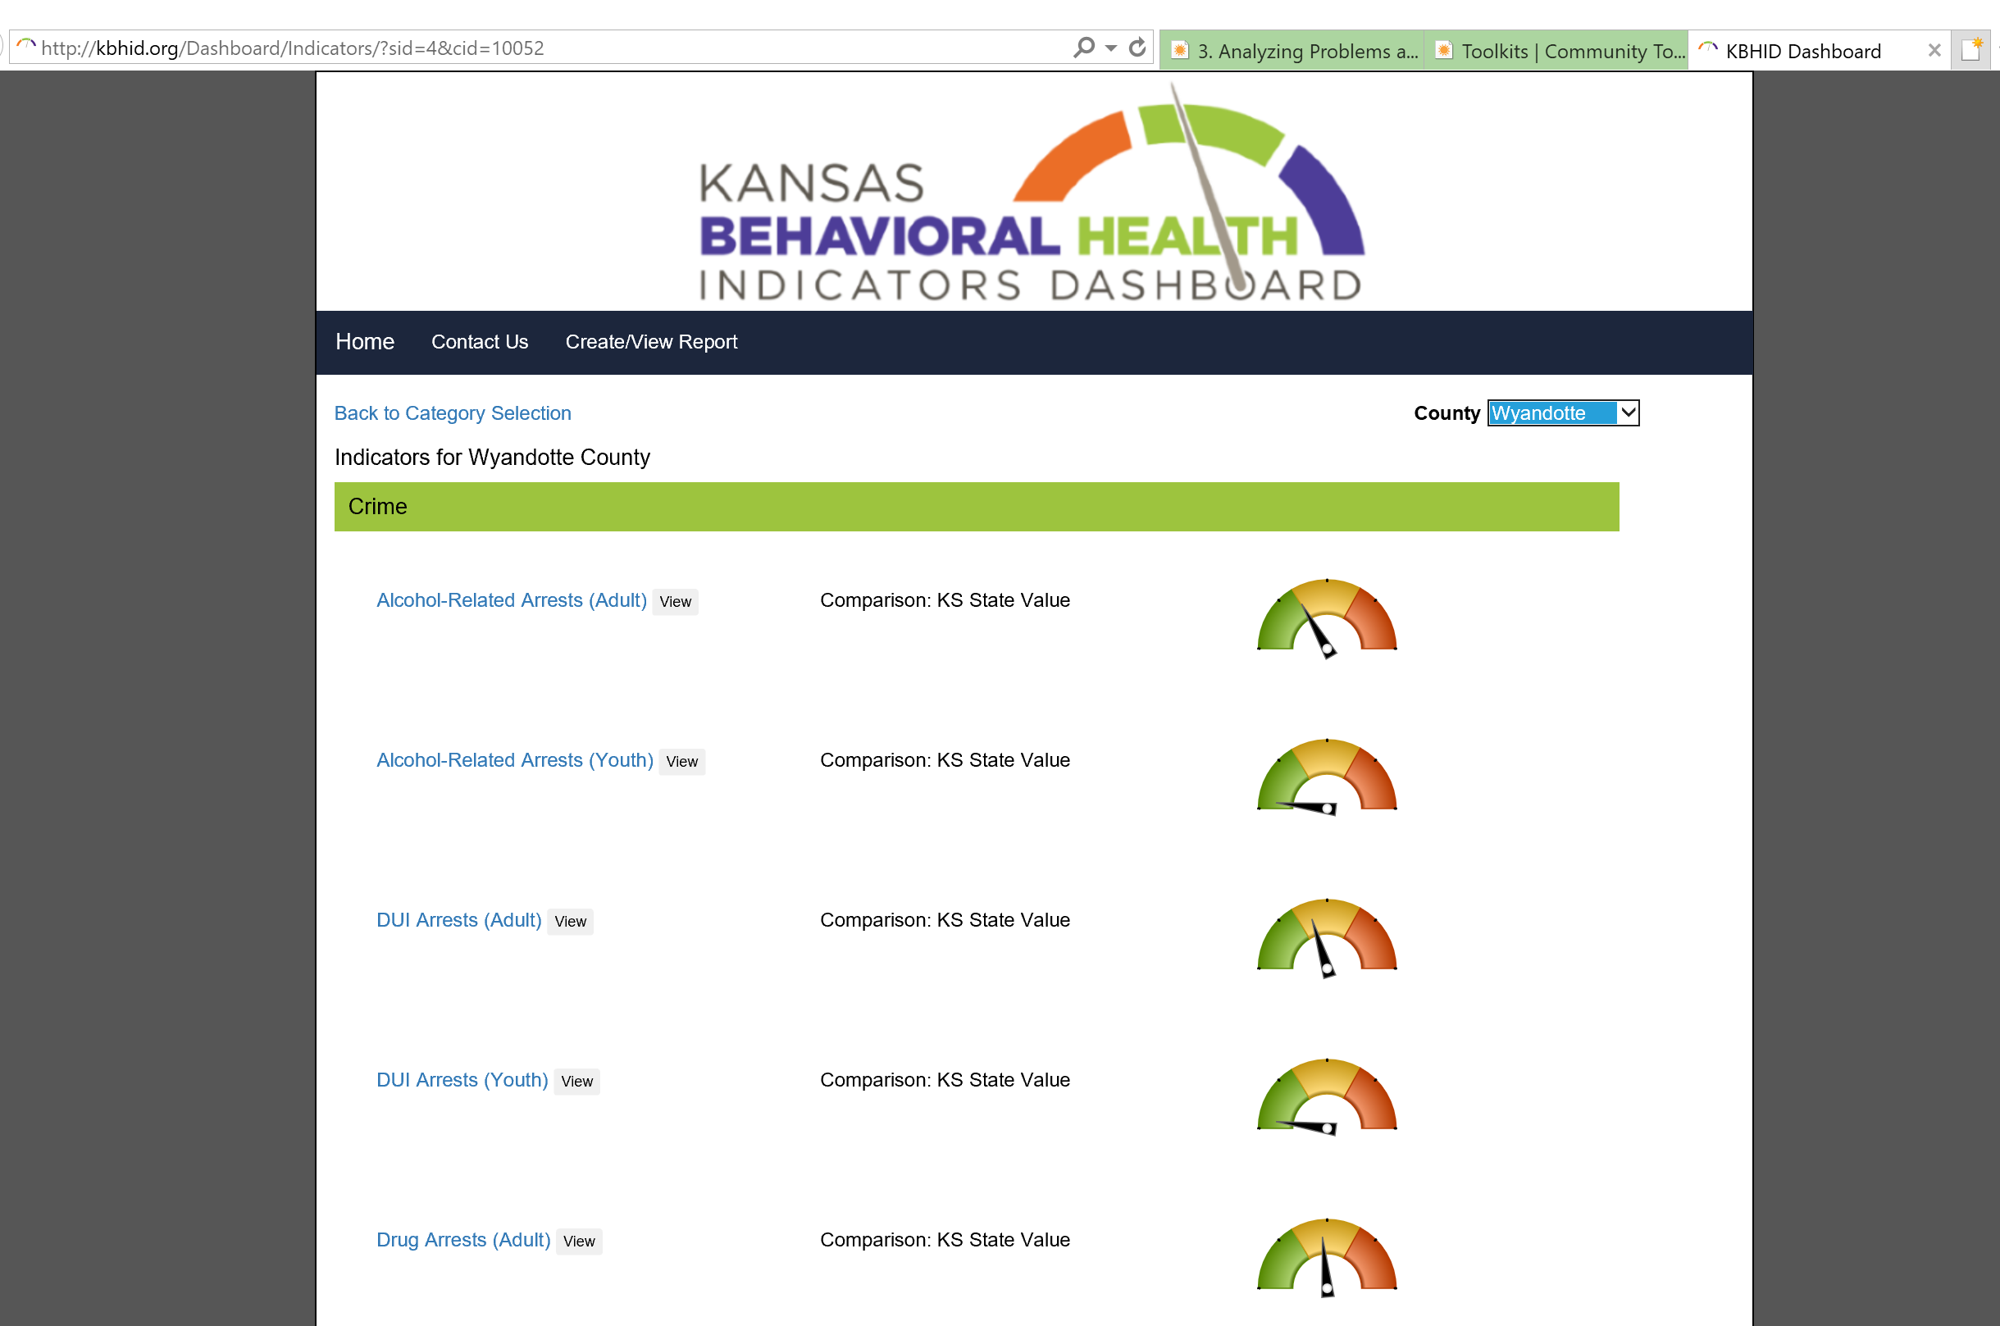

Slide 20
KDOC – Services in Proposal & Adapted Timeline
Convene JJCE Action Team bimonthly (March ‘19)
Develop and document in CCB (March ’19 to Sept ’20)
Conduct community needs and resources assessment (Mar ‘19 to July ’19)
JJCE Action Team identifies sub-populations experiencing disparities and appropriate consultants and TA providers to enhance local understanding
Provide YJCEI Report (Sep ’19)
Develop and implement juvenile justice community engagement action plan (Sept ‘19 to Dec ‘19)
Develop and update online data portal with KBHID (July ‘19 to Sept 19)
Pilot tools, resources, guidance documents for toolkit (Aug ’19 to Aug ‘20)
Toolkit includes, minimally: assessment and strategic and action planning guide

Slide 21
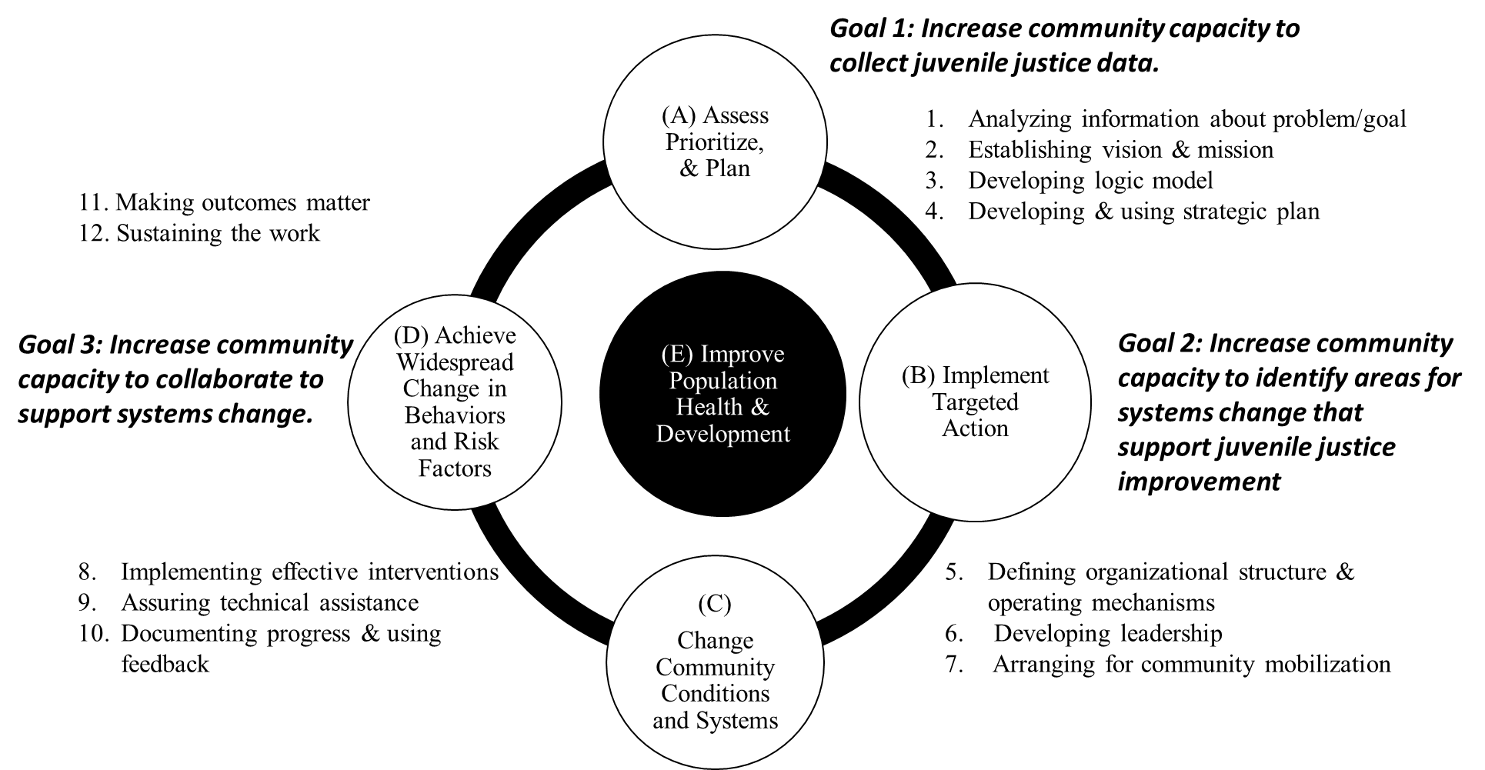

Slide 22
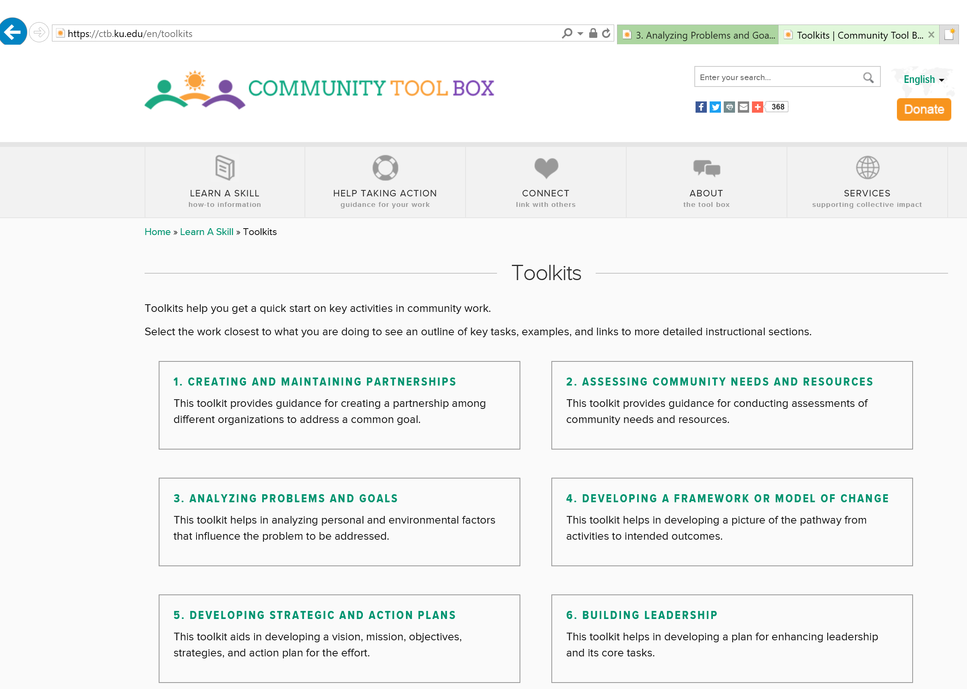

Slide 23
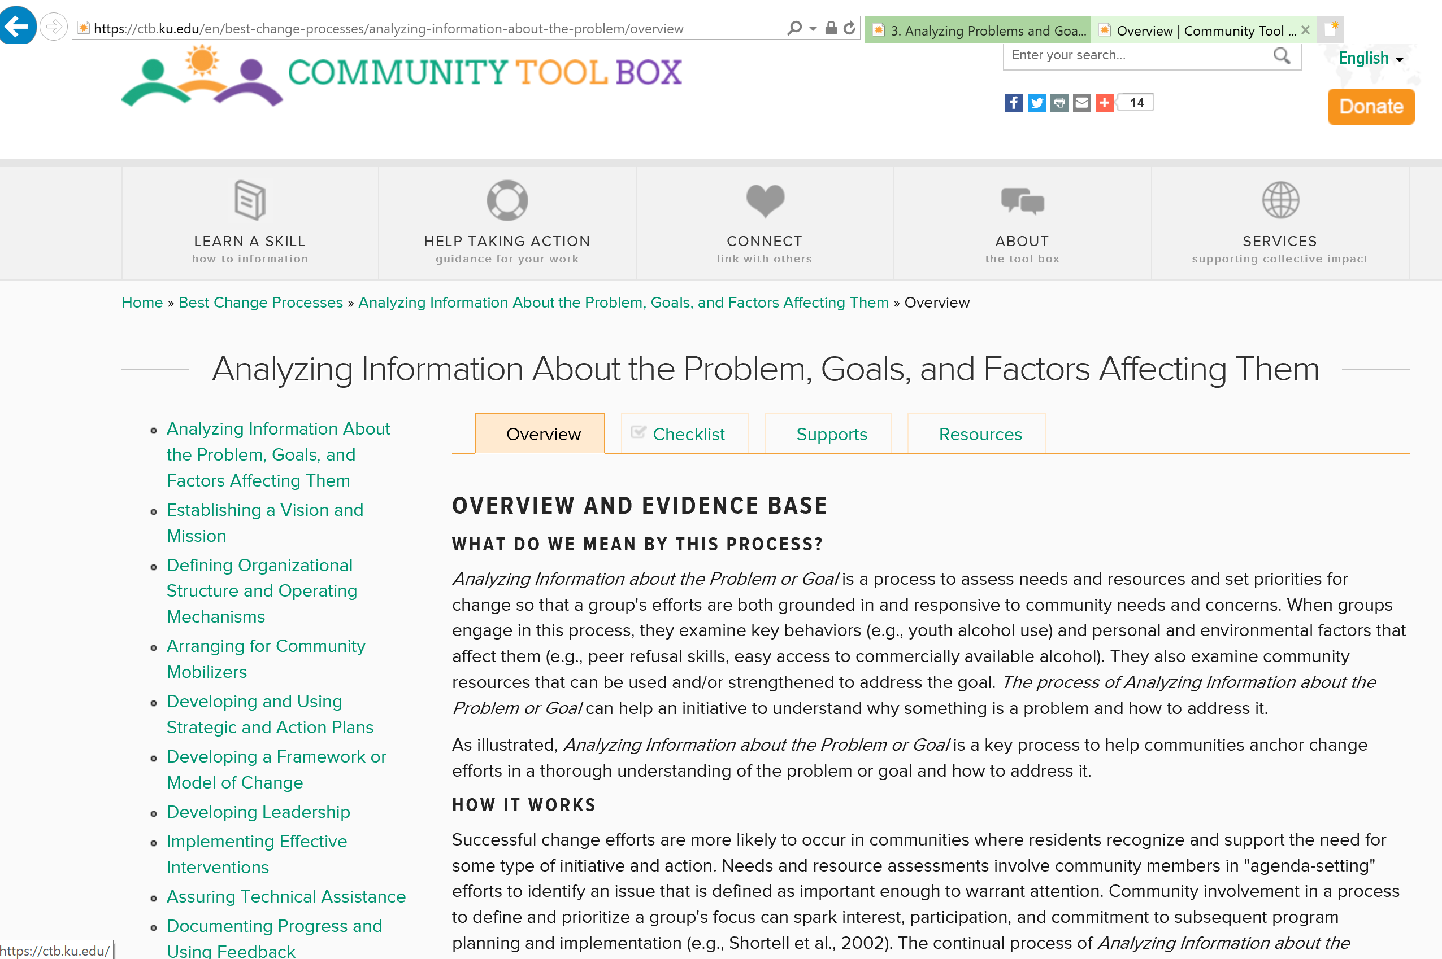

Slide 24
KDOC-Community Engagement Milestones and Timeline
Core Tasks: | Dec ‘18 | Jan ‘19 | Feb ‘19 | Mar ‘19 | Apr ‘19 | May ‘19 | Jun ‘19 | Jul ‘19 | Aug ‘19 | Sep ‘19 | Oct ‘19 | Nov ‘19 | Dec ‘19 | Jan ‘20 | Feb ‘20 | Mar ‘20 | Apr ‘20 | May ‘20 | Jun ‘20 | Jul ‘20 | Aug ‘20 | Sep ‘20
Convene JJCE Action Team Bimonthly
CCB Documentation
Stakeholder data mapping
Assessment Plan developed
Consult with subject matter experts for sub-populations
Conduct community needs and resources assessment
Disseminate report
Develop and implement juvenile justice community engagement action plan
Develop and update online data portal with KBHID
Pilot tools, resources, guidance documents for toolkits

Slide 25
Identifying Assessment Purpose & Questions
What do we want to know or better understand?

Slide 26
Tasks for Conducting Community Assessments
Task 1: Identify Purpose
Task 5: Develop and Implement Plan
Task 6: Analyze Results
Task 8: Use Assessment to Guide Planning & Action
Task 4: Enhance Community Capacity
Task 7: Communicate the Results of the Assessment
Task 3: Identify Appropriate Methods
Task 2: Determine Components

Slide 27
Tasks for Conducting Community Assessments
Task 1: Identify Purpose

Slide 28
SPECIFIC KDOC COMMUNITY ENGAGEMENT GOALS
MAKE PROGRESS
GOAL 1
GOAL 2
GOAL 3
Increase community’s data analysis and interpretation capacity.
Complete a thorough data analysis of juvenile justice data from the past three years. Identify areas where outcomes for youth could be improved via justice system improvement or other system interventions
Increase community’s collaborative capacity. Assist to identify and approach other stakeholders that need to be brought in to address the identified system improvement needs
Increase community capacity to collect data from juvenile justice decision points.
Assist in collecting data for last three fiscal years
Notes:
1. Opportunity for year-round community program, including resource for summer program that we hope in partnership with schools
2. Awarded by HHS, OMH MYVPP2 Grant Program; FY17 Minority Youth Violence Prevention II (MYVP II): Integrating Social Determinants of Health and Community Policing Approaches
1 of 10 grantees (Loyola Univ-Chicago, Rutgers- NJ, Kentucky State Univ, ST Louis County Dept of PH,
3. 1 year grant of 4 year grant award-- Award amount is $425,000 (approximately $300,000 for Direct Costs for Project)
4. 3 Aims

Slide 29
Why? What?
Why is it important to support a juvenile justice system assessment?
What does success look like for youth? What does success look like for youth who are justice involved?
What does success look like for our juvenile justice system?
What are we doing well in the juvenile justice system?
What are some challenges?
What are the problems and goals we can address through the juvenile justice system assessment?

Slide 30
Kansas Juvenile Justice Process

Slide 31
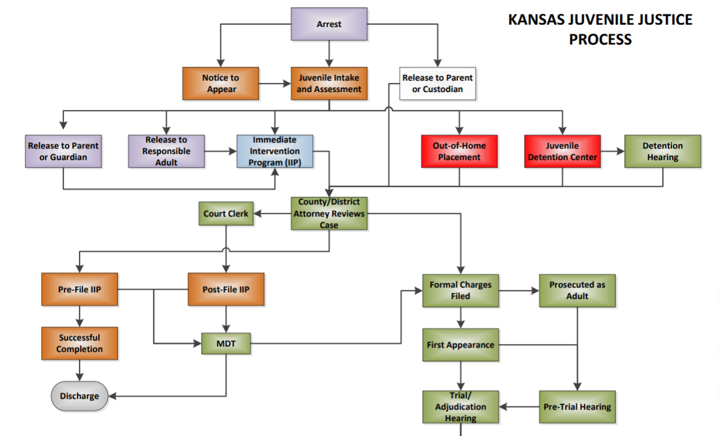
Notes:
https://www.doc.ks.gov/juvenile-services/partners
Each judicial district is required to have three core programs operational at the local level:
Juvenile Intake and Assessment (JIAS)
Juvenile Intensive Supervision Probation (JISP)
Community Case Management (CCMA)

Slide 33
Who Needs to be at the Table?
What key organizations, agencies, groups, or indivdiuals need to be involved in assessing JD #29?
Who needs to be involved from the other municipalities in JD #29?

Slide 34
Tasks for Conducting Community Assessments
Task 1: Identify Purpose
Task 2: Determine Components

Slide 35
Why? What?
How will we know when we have been successful in improving outcomes?
How will we know when we have enhanced capacity of our juvenile justice system?
What do we need to better know and understand?
What data do we have or need?

Slide 36
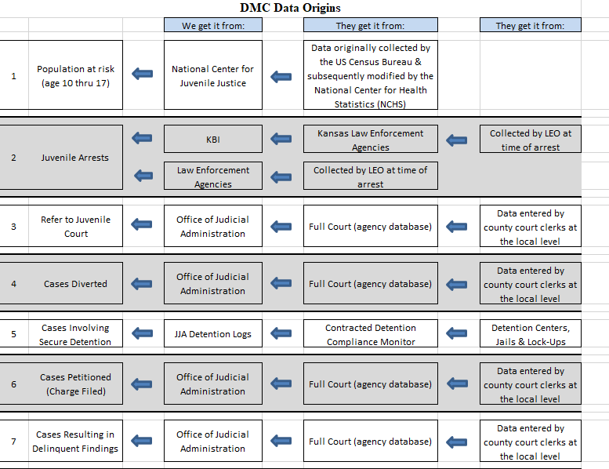

Slide 37
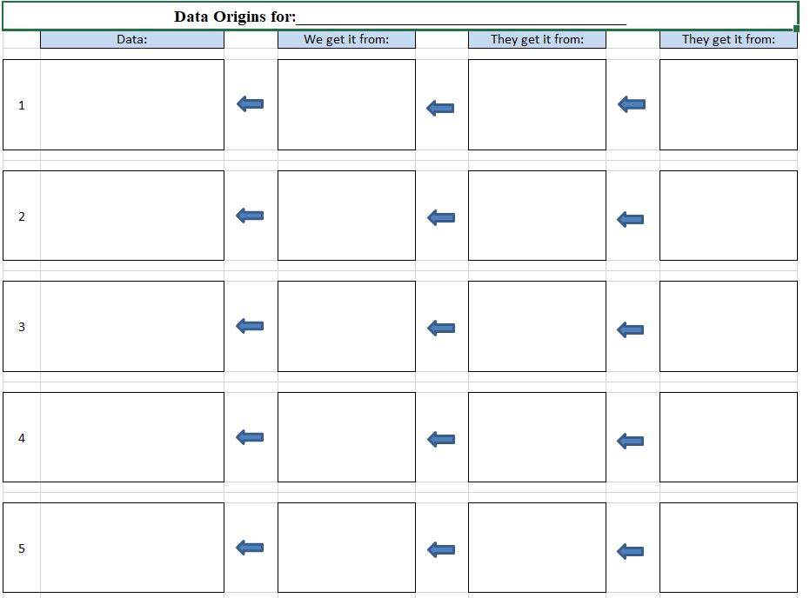
What type of data or information are we interested?
Who are stakeholders who may have information that is of interest?
Who are other stakeholders who should be at the table?

Slide 38
Next Steps

Slide 39
What’s Next?
Data collection plan discussion
Stakeholder Mapping/Stakeholder Data Mapping
Review Network Analysis
Individual Informational Interviews
Focus groups
Capacity Surveys
Community Engagement
Send joint letter with Judge York to stakeholder group to inform of YJCEI
Engage Community in interview, focus, group, survey process
Convene ThrYve YJCE Collaborative to Review Assessment & Planning

Slide 40
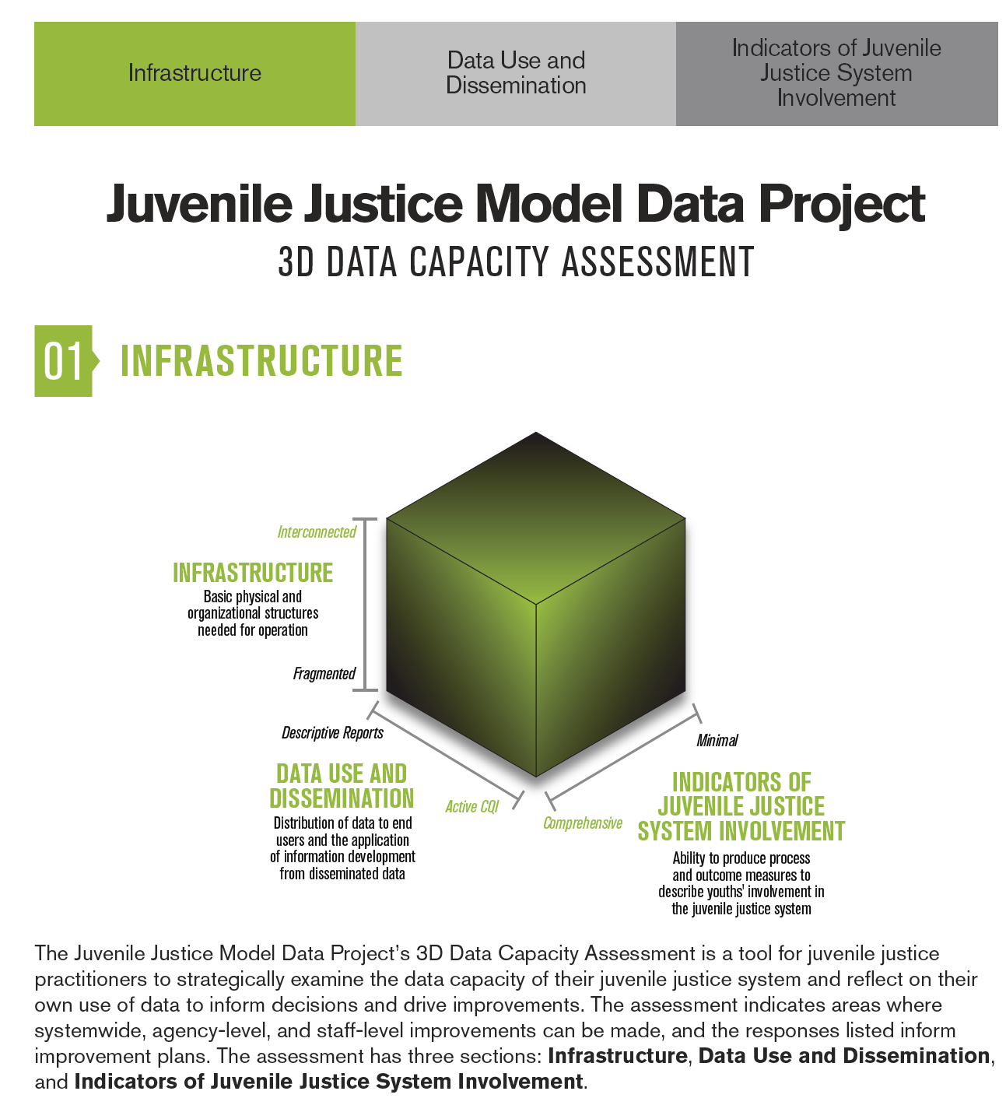

Slide 41
ThrYve Youth Justice & Crime Prevention Action Team
Action Plan Review and Discussion

Slide 42
For Additional Information Contact:
Email: thryve@ku.edu
Website: www.wethryve.org
Instagram: #wethyrve
LinkedIn: ThrYve Youth Violence Prevention Project
Jomella Watson-Thompson, Ph.D.
Associate Professor/Associate Director
Center for Community Health and Development|@KUCommHealth |
University of Kansas
785.864.1563 (p)
jomellaw@ku.edu
Notes:
How schools and buildings got involved and fits into work
Note Attended Listening Session at WYHS and what to do that’s different (Engage Administrators/Principals, Engage Teachers (HPS);
Want MOA to go deeper in program
Partner with Other Programs
Share resources (e.g., buses on Wed Early release);
Broker Community Resources;
Coordinate programming through SAB
Share school resources (transportation, meeting space after school)
Staff and Community Progrma Support
Cultural Competence, fair and implicit training
Data Sharing
Academic records each semester including, GPA, grades, absences, attendance, promotions, graduation, suspension/expulsion, disciplinary referrals and actions
Kansas Communities that Care (KCTC) building-level data and student-level data for students in the THRYVE cohort.
School-based clinic data including reason, diagnosis, and outcome of the clinic visit for students in the cohort receiving services through Bull Doc Clinic at Wyandotte High School
Year-Round Supports for Students
Summer and Community Program
In-School (SBVP, Tutoring, School Specified Supports) & Out of School Supports (Wed early release, weekends,)
Supplemental Notes from MOA:
Specifically, the THRYVE/KU CCHD aims to provide services to the cohort of students enrolled in the program through the following:
Provide afterschool prevention programming for students on Wednesday early release day using evidence-based prevention curriculum (e.g., Youth Empowerment Solutions).
Assist students and their families in developing and implementing personal life plans to address individual and family needs and goals through coaching and navigation supports.
Provide tutoring supports for students enrolled in the cohort.
Provide supports for students and families, in partnership with the Bull Doc Clinic Mental Health component, including through conflict resolution, grief groups, and by offering family-level counseling supports.
Gather and analyze data for students enrolled in the THRYVE cohort to evaluate the health outcomes, student academic measures, and other indicators of effectiveness.
Develop and present an annual report to the USD 500 summarizing the THRYVE outcomes related to the school-based services and supports.
The THRYVE/KU CCHD aims to provide school-wide supports to support violence prevention through the following:
Assess, develop, and provide secondary trauma supports to teachers and staff.
Identify, support, and build the capacity of teachers and students to facilitate restorative justice practices (e.g., conflict mediation, conflict resolution skills training).
Gather, document, and analyze data to examine the development and implementation of school-wide practices to prevent and reduce violence.
Develop and present an annual report to the USD 500 summarizing the THRYVE outcomes related to the school-based services and supports.
Section 7: Purpose and Scope: USD 500 in Support of the THRYVE
The USD 500 supports the THRYVE/KU CCHD in efforts to prevent and reduce violence in the school and community. Specifically, the USD 500 aims to:
Provide meeting space in the school to support the school-based activities of THRYVE, including on Wednesday for minimally two hours during after-school hours.
Provide transportation assistance that adheres to district policies, including through the provision of an activity bus.
Maintain regular and consistent communication with the THRYVE/KU-CCHD, including through participation in regularly established meetings with THRYVE/KU-CCHD to plan, collaborate and support the effort.
Collaborate with other district programs and services including, but not limited to transportation services, nutritional services, student services, and the KCKPS Police Department.

Slide 43
I ThrYve, You ThrYve, We ThrYve!
Notes:
This is why we are collaborating with partner to support the development and implementation of the KCK YVP2, which is a multi-component or comprehensive strategy to address multiple risk factors or determinants of health to contribute to preventing and reducing youth violence.
Our collaborative approach is not focused on attribution (meaning one program), but in our collective contribution to modify the environment (including the systems) to support improvements in outcomes.
Questions and Feedback

Slide 44
ThrYve Approach Together Helping Reduce Youth Violence for Equity
Universal: Broader Community-Level Strategies
Targeted: Focused Supports for 120 Youth (7th-10th grades) & Families in Priority Area
College Savings Account & Finance Training
College Readiness, Access, & Coaching (LEAD UP)
Employment Prep & Placement
Community-Based Program Electives
Youth Leadership Skills (YES!)
Social-Emotional Skills
Systems Advisory Board
Community & System Change Levers (Community Playbook)
Multi-Sector Collaborative Action Teams
Culturally competent, impartial, & trauma-informed approaches
Youth Violence Prevention & Intervention Programs
School-Based Violence Prevention Programs
Hospital-Based Violence Intervention Program (REVIVE)
Community-Based Crime Prevention (CPTED)
Out-of-School Time Supports
Out-of-School Time Menu
Youth Advisory Board
Education, College, & Career Readiness Supports
Cultural Enrichment Programs & Activities
Parent & Family Engagement
Parent/ Guardian Training Menu
Family & Youth Playbook (Plan)
Family & Youth Counseling Menu & Supports
Community Service Activities
Preferred Leisure Alternatives for Youth (PLAY)
Academic Supports, Tutoring, STEAM Training
Life Skills
Soft Skills
Fostering Community Change through Collaboration, Planning, and Evaluation
Citation: Center for Community Health and Development. (2018). ThrYve Approach. Lawrence, KS University of Kansas. Retrieved from https://wethryve.ctb.ku.edu/approach/

Slide 45
Short-term Objectives in Proposal
Goal 2: Increase community capacity to identify areas for systems change that support juvenile justice improvement based on assessment
2.1: By July 2019 (Mar. 2019), provide training or consultation for JJCE Action Team to assess and implement strategies for sub-populations experiencing DMC, trauma, and LGBTQI youth.
2.1a: Consult with subject-matter experts to examine issues for priority sub-populations
2.2: By September. 2019, disseminate Juvenile Justice Community Needs & Resources Assessment Report
2.2a: CCHD, TLI, and Action Team will analyze data by magnitude, trend, and ratio to other districts or state data. Discuss and increase community buy-in and capacity
2.3: By December 2019, strategic and action plan completed based on assessment findings
2.3a: Develop strategic and action planning guide toolkit
2.3b: Facilitate community planning process
2.3c: Present plan to stakeholders and support implementation

Slide 46
Long-term Objectives in Proposal
Goal 3: Increase community capacity to collaborate to support systems change
3.1: By Dec. 2018, develop a CCB for JJCE Action Team.
3.1a: Document the community engagement implementation of systems changes
3.2: By Nov. 2019, develop online dashboard to store juvenile justice data online
3.2a: Data posted as part of KBHID. LTI provides training to community to interpret reports and navigate system. Further trainings provided on assuring implementation fidelity, and writing community goals and monitoring progress with data.
3.3: By Aug. 2020, develop two toolkits, one for community assessment and one for strategic and action planning
3.3a: identify effective practices and policies that were supported and develop toolkit modules related to effective practices to support KDOC and local partners.

Slide 47
Long-term Objectives in Proposal
Goal 3: Increase community capacity to collaborate to support systems change
3.1: By Dec. 2018, develop a CCB for JJCE Action Team.
3.1a: Document the community engagement implementation of systems changes
3.2: By Nov. 2019, develop online dashboard to store juvenile justice data online
3.2a: Data posted as part of KBHID. LTI provides training to community to interpret reports and navigate system. Further trainings provided on assuring implementation fidelity, and writing community goals and monitoring progress with data.
3.3: By Aug. 2020, develop two toolkits, one for community assessment and one for strategic and action planning
3.3a: identify effective practices and policies that were supported and develop toolkit modules related to effective practices to support KDOC and local partners.

Slide 48
Long-term Objectives in Proposal
Goal 3: Increase community capacity to collaborate to support systems change
3.1: By Dec. 2018, develop a CCB for JJCE Action Team.
3.1a: Document the community engagement implementation of systems changes
3.2: By Nov. 2019, develop online dashboard to store juvenile justice data online
3.2a: Data posted as part of KBHID. LTI provides training to community to interpret reports and navigate system. Further trainings provided on assuring implementation fidelity, and writing community goals and monitoring progress with data.
3.3: By Aug. 2020, develop two toolkits, one for community assessment and one for strategic and action planning
3.3a: identify effective practices and policies that were supported and develop toolkit modules related to effective practices to support KDOC and local partners.

Slide 49
Year 1 Project Milestones
October 2018 through December 2019
April to June 2019
Establish Partnerships
Bimonthly SAB meeting
Bimonthly SAB
January to March 2019
Establish MOU with USD #500
July to September 2019
Staff Training
ThrYve Summer Launch
Identify summer community/ systems change levers
Begin Data Collection
Identify additional community/ systems change levers
Juvenile Justice System Partner Meetings
Staff Support Acquired
Training and TA from subject matter experts biannually (Mar ‘19 to Sept ’20)
Conduct community needs and resources assessment (Mar ‘19 to Jun ’19)
Bimonthly YJCEI Steering Committee meetings
Conduct community needs and resources assessment (Mar ‘19 to Jun ’19)
Develop and document in CCB (Dec ’18 to Sept ’20)
Adapt WorkStation Online Portal
Bimonthly SAB & YJCEI meetings
Bimonthly SAB & YJCEI meetings
Notes:
Share timeline and update and show where we are
Frame as community issue and convening partners
W:\Projects Current\KCK-YVPP-- HHS\1. Admin- Project Level\Funded Proposal\Funded Submission\Appendices\A2

Slide 50
Year 2 Project Milestones
October 2019 through December 2020
April to June 2020
Establish Partnerships
Bimonthly SAB meeting
Bimonthly SAB
January to March 2020
Establish MOU with USD #500
July to September 2020
Bimonthly SAB & YJCEI meetings
Staff Training
ThrYve Summer Launch
Identify summer community/ systems change levers
Continue year-round supports for youth
Identify additional community/ systems change levers
Begin Data Collection
)
Juvenile Justice System Partner Meetings
Staff Support Acquired
Training and TA from subject matter experts biannually (Mar ‘19 to Sept ’20)
Conduct community needs and resources assessment (Mar ‘19 to Jun ’19)
Bimonthly YJCEI Steering Committee meetings
Conduct community needs and resources assessment (Mar ‘19 to Jun ’19)
Develop and document in CCB (Dec ’18 to Sept ’20)
Adapt WorkStation Online Portal
Bimonthly SAB & YJCEI meetings
Notes:
Share timeline and update and show where we are
Frame as community issue and convening partners
W:\Projects Current\KCK-YVPP-- HHS\1. Admin- Project Level\Funded Proposal\Funded Submission\Appendices\A2

Slide 51
References & Information Sources
http://www.kscourts.org/districts/District-Info.asp?d=29
https://www.doc.ks.gov/juvenile-services/Webline/2018/October/view
JDAI https://www.aecf.org/work/juvenile-justice/jdai/
https://www.jocogov.org/dept/corrections/juvenile-services/juvenile-detention-alternatives-initiative
https://www.wycokck.org/DA/Divisions.aspx
https://www.doc.ks.gov/newsroom/stories/archived-news-stories/2015/WYCO
https://www.doc.ks.gov/juvenile-services/partners/juvenile-intake-assessment
JIAC https://www.wycokck.org/Sheriff/Divisions.aspx
https://www.wycokck.org/Sheriff/Contact.aspx
KS Appleseed
JIAC
JCAB

Slide 52
ThrYve Approach Together Helping Reduce Youth Violence for Equity
Universal: Broader Community-Level Strategies
Targeted: Focused Supports for 60 Youth (8th-11th grades) & Families in Priority Area
College Savings Account & Finance Training
College Readiness, Access, & Coaching (LEAD UP)
Employment Prep & Placement
Community-Based Program Electives
Youth Leadership Skills (YES!)
Social-Emotional Skills
Systems Advisory Board
Community & System Change Levers (Community Playbook)
Multi-Sector Collaborative Action Teams
Culturally competent, impartial, & trauma-informed approaches
Youth Violence Prevention & Intervention Programs
School-Based Violence Prevention Programs
Hospital-Based Violence Intervention Program (REVIVE)
Community-Based Crime Prevention (CPTED)
Out-of-School Time Supports
Out-of-School Time Menu
Youth Advisory Board
Education, College, & Career Readiness Supports
Cultural Enrichment Programs & Activities
Parent & Family Engagement
Parent/ Guardian Training Menu
Family & Youth Playbook (Plan)
Family & Youth Counseling Menu & Supports
Community Service Activities
Preferred Leisure Alternatives for Youth (PLAY)
Academic Supports, Tutoring, STEAM Training
Life Skills
Soft Skills
Fostering Community Change through Collaboration, Planning, and Evaluation
Citation: Center for Community Health and Development. (2018). ThrYve Approach. Lawrence, KS University of Kansas. Retrieved from https://wethryve.ctb.ku.edu/approach/
Notes:
Jomella
The strategic components of the project are categorized into two main categories: universal broader community level strategies and targeted focused supports for our cohort of youth. I’ll describe these components in further detail in the next slides.

Slide 53
Top 5 - Juvenile Justice Action Team
Partners
Youth
Establish a silent witness hotline for reporting violence, including physical and sexual abuse.
Provide skill training in how to avoid or walk away from potentially violent situations without a loss of respect.
Provide a coordinated program of "wrap around" services for youth involved in violent crimes that includes juvenile court, schools, and social and rehabilitate services.
Establish programs for police officers to work with youth in alternative activities and education
Improve night and street lighting and supervision in public parks and recreational areas.
Establish a silent witness hotline for reporting violence, including physical and sexual abuse.
Strengthen and enforce laws regarding buying, selling, or possession of firearms by youth.
Establish programs for police officers to work with youth in alternative activities and education
Cooperate with the media to communicate accurate information on the level of violence, including violence among youth.
Reduce the waiting period between actual arrest and final disposition for violent crimes.

Slide 54
Top 5 - Trauma, Social Services, Support AT
Partners
Youth
Establish a peer support program for at-risk youth and/or those attempting to get away from gang involvement.
Establish intervention programs for those who are witness to violence, such as murder of a friend or family member.
Provide information and training to teachers, parents, and guardians about what to look for and how to promote health and safety in children and youth (e.g., through newsletter, in‐service training, schools, and local libraries).
Conduct annual school-based health fairs with an emphasis on youth health issues, including physical assault, incest, and sexual abuse.
Establish and increase use of silent witness and related youth crisis hotlines.
Provide incentives for Emergency Room staff who get additional training to deal with victims of violence.
Provide information and training to teachers, parents, and guardians about what to look for and how to promote health and safety in children and youth (e.g., through newsletter, in‐service training, schools, and local libraries).
Provide training for all Emergency Room staff to instruct them in appropriate ways of dealing with victims of violence and persons arriving with the victims.
Establish crisis intervention teams to address extreme or repeated instances of conflict among family members.
Establish and increase use of silent witness and related youth crisis hotlines.

Slide 55
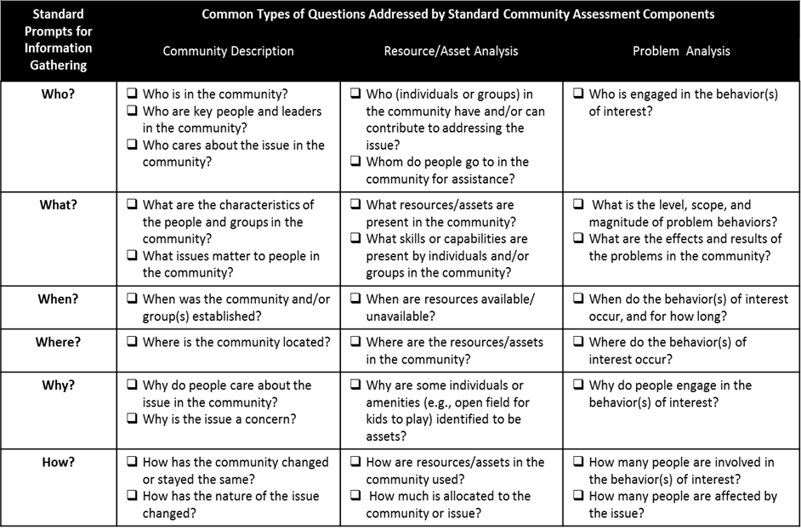
Notes:
1.) Point out three components of assessment (circle)
a. All assessments may sometimes include different components
b. Questions for consideration

Slide 56
